Slide 1

WELCOME
COHORT 5
7th Sept – 3rd Dec 2026
Suite 6-6-7, Level 6, Menara MAA

Slide 2
Conditional Rendering Fundamentals
What is Conditional Rendering?
Displaying different UI elements based on certain conditions
Core concept for dynamic user interfaces
Essential for responsive and interactive applications

Slide 3
Conditional Rendering Fundamentals
Why Conditional Rendering Matters:
User experience optimization
Performance benefits (don't render unnecessary elements)
Clean, maintainable code structure
Dynamic content based on state/props

Slide 4
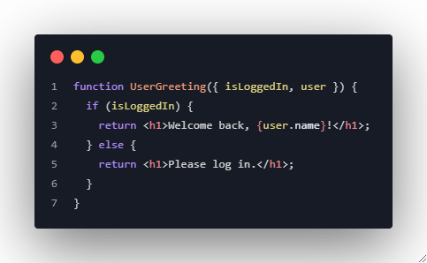
Conditional Rendering Techniques
If/Else Statements (Outside JSX)

Slide 5
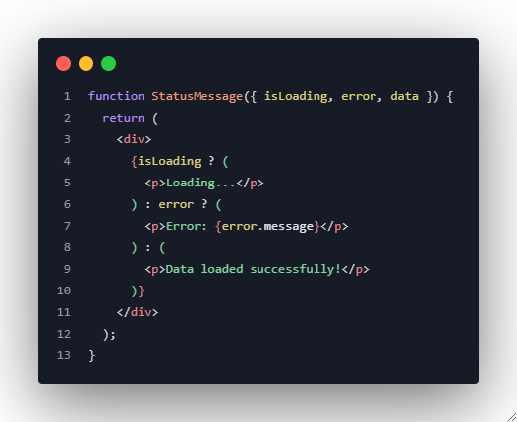
Conditional Rendering Techniques
Ternary Operator (Inline)

Slide 6
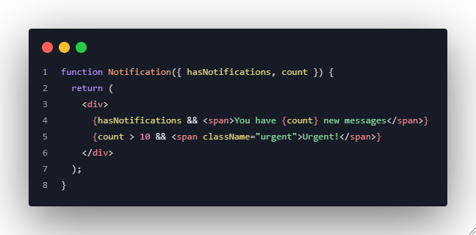
Conditional Rendering Techniques
Logical AND Operator (&&)

Slide 7
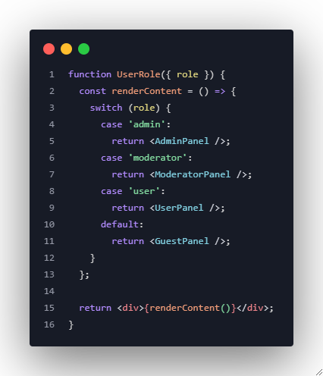
Conditional Rendering Techniques
Switch Statements (For Multiple Conditions)

Slide 8
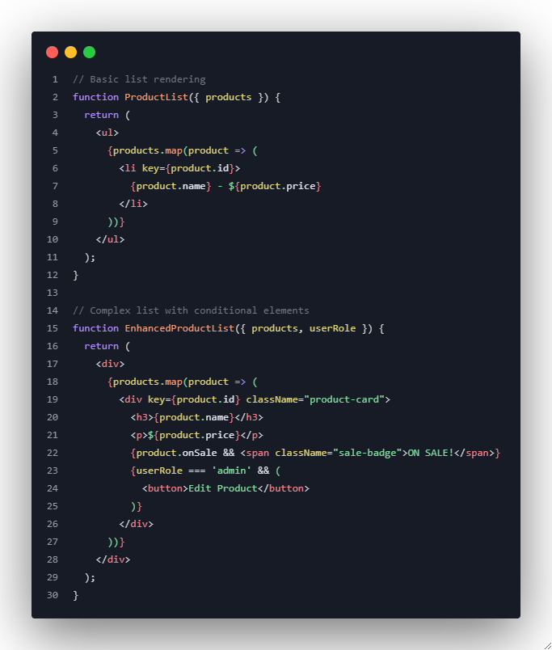
Conditional Rendering Techniques
Dynamic Lists and the map() Function

Slide 9
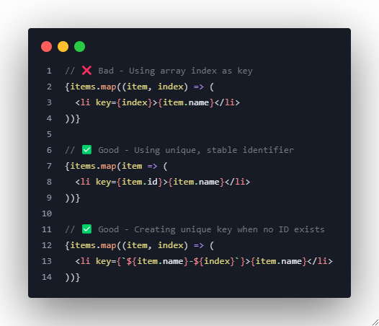
Conditional Rendering Techniques
Understanding Keys and Their Importance

Slide 10
Conditional Rendering Techniques
Why Keys Matter:
React uses keys to identify which items have changed
Improves performance during re-renders
Prevents bugs with component state
Essential for proper list updates

Slide 11
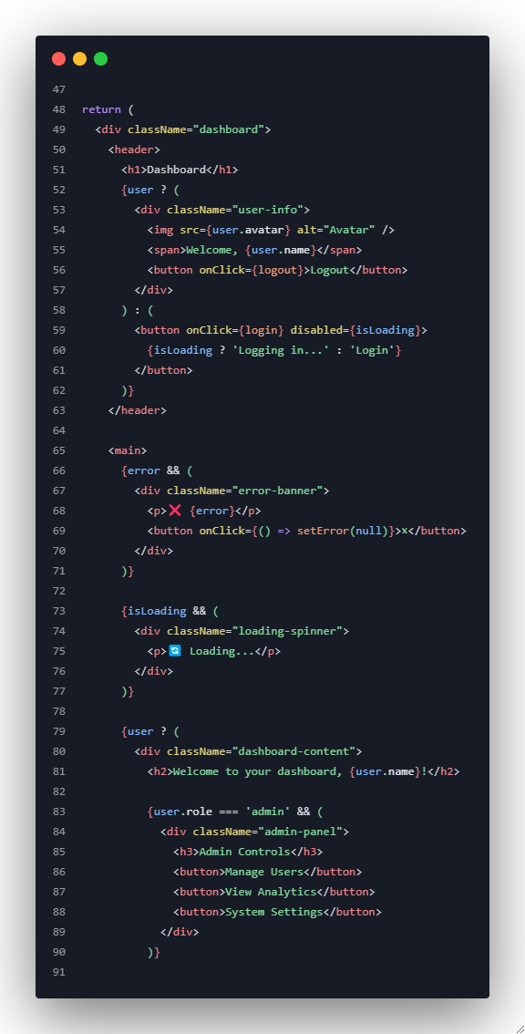
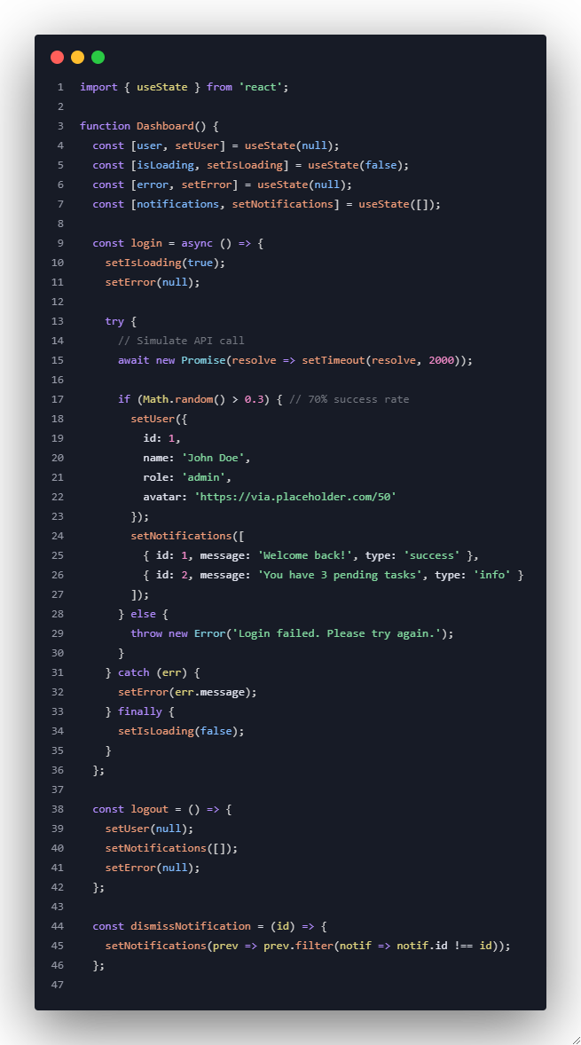
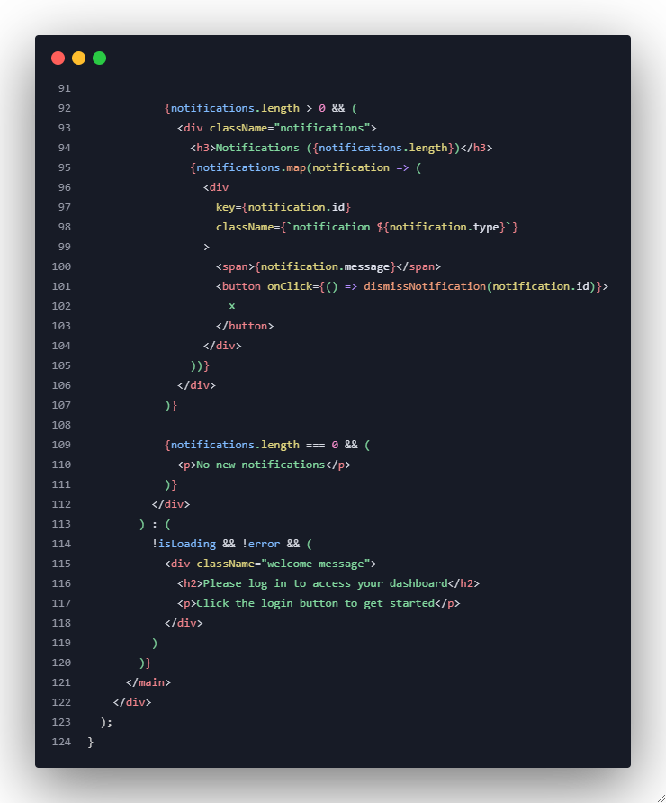
Example 1: Multi-State Dashboard

Slide 12
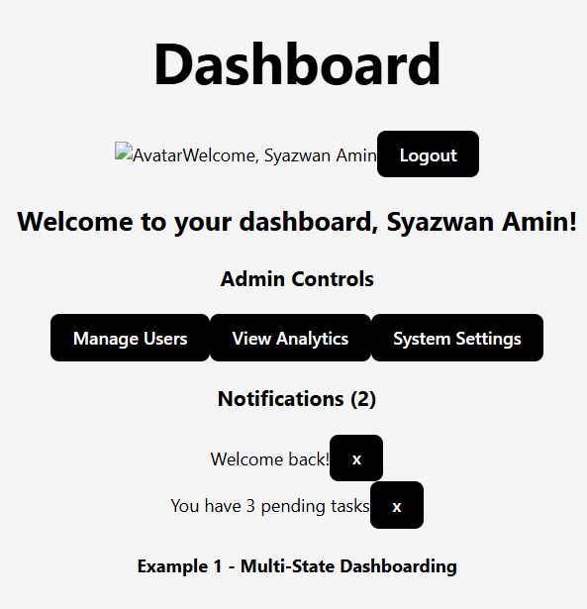
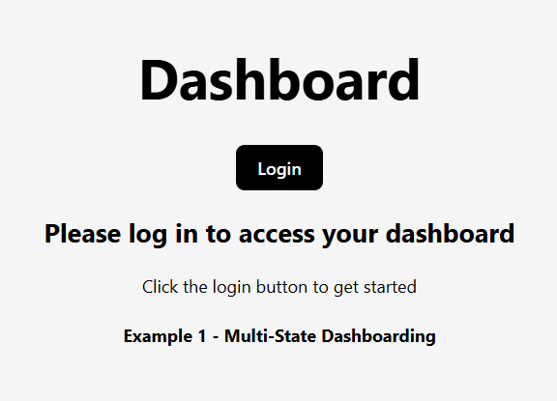
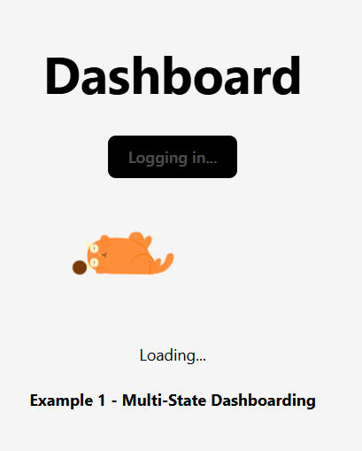
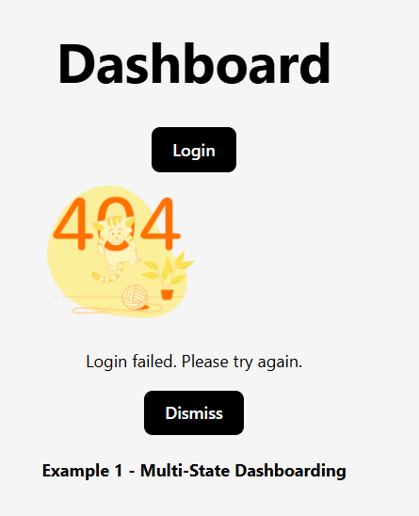
Example 1: Multi-State Dashboard
State to hold the logged-in user's data.
State to hold a list of notifications for the user.
onClick login button
If successed login
State to store any error messages from the API call.
If failed login
Default output of Dashboard.jsx component or function (Dashboard)
State to track if data is being fetched; true during API calls
Notes:
Extra Challenge – Implement loading animation using Lottiefiles:
Loading when logging in.
Loading when login failed.

Slide 13
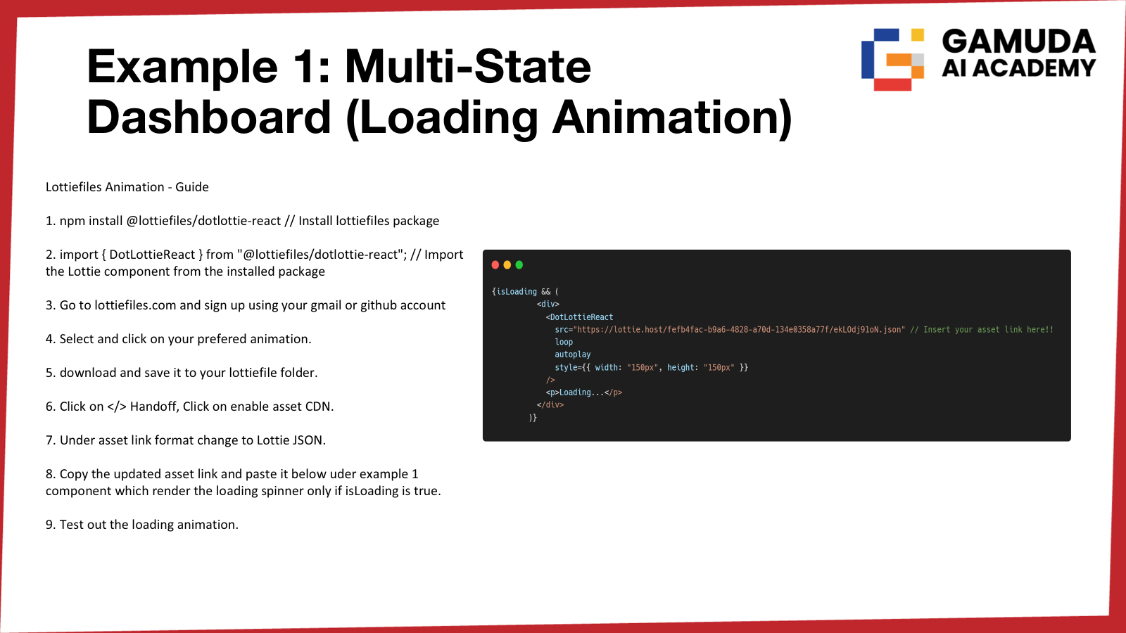
Notes:
Extra Challenge – Implement loading animation using Lottiefiles:
Loading when logging in.
Loading when login failed.

Slide 14
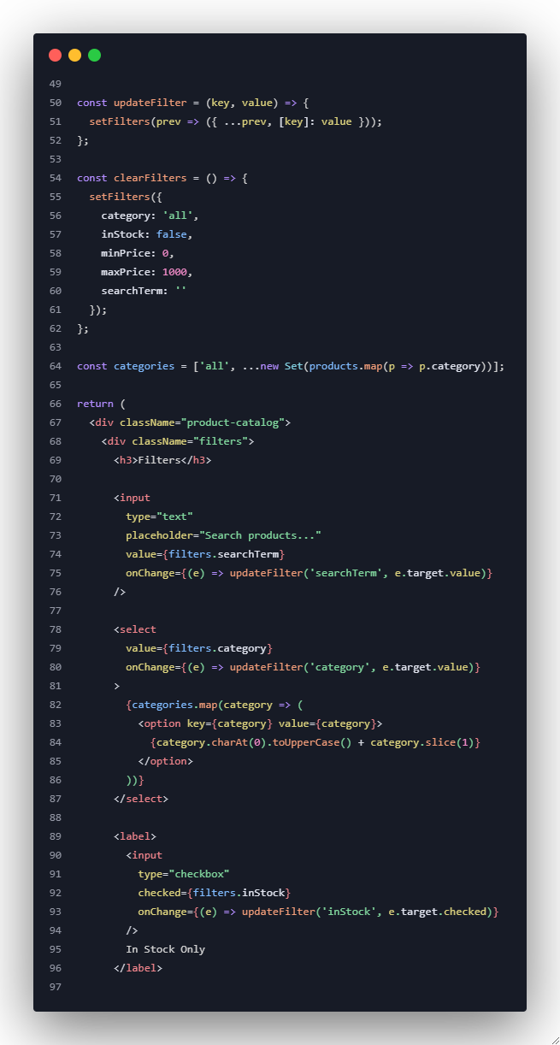
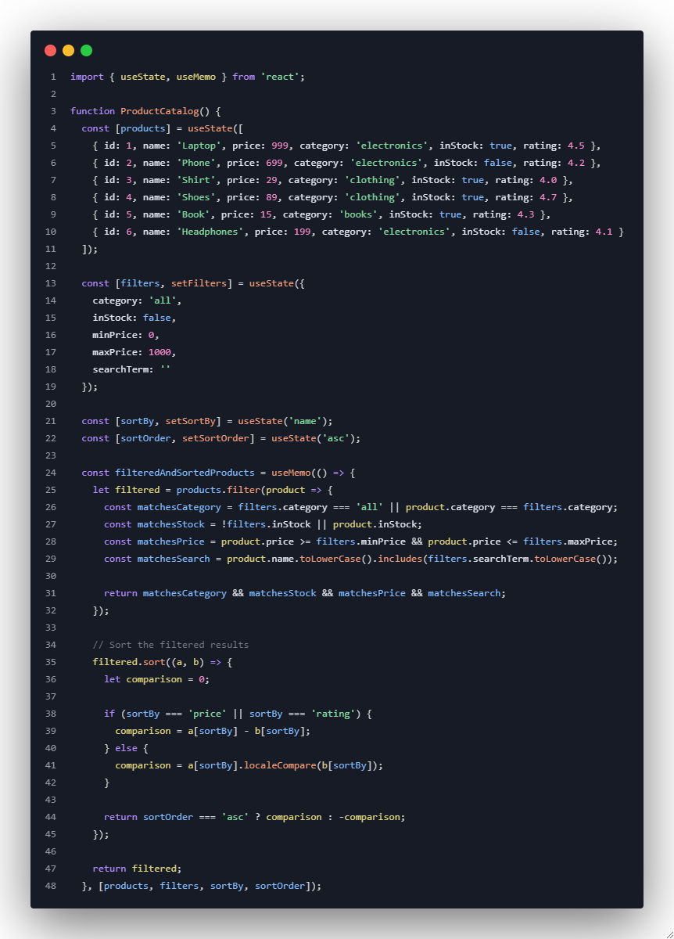
Example 2: Advanced Product Filter and Sort

Slide 15
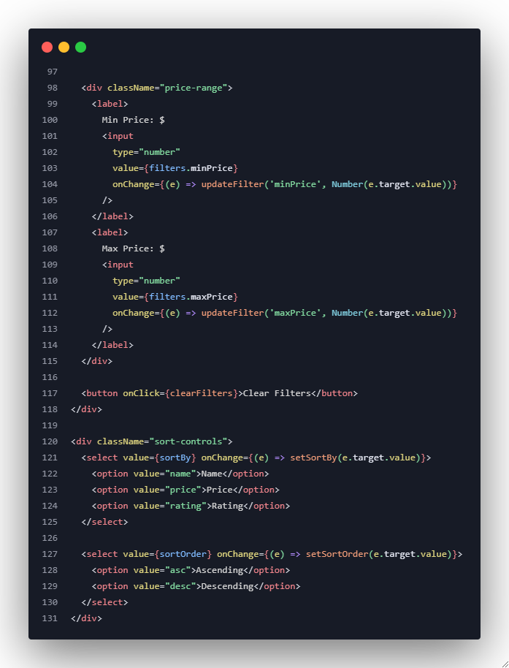
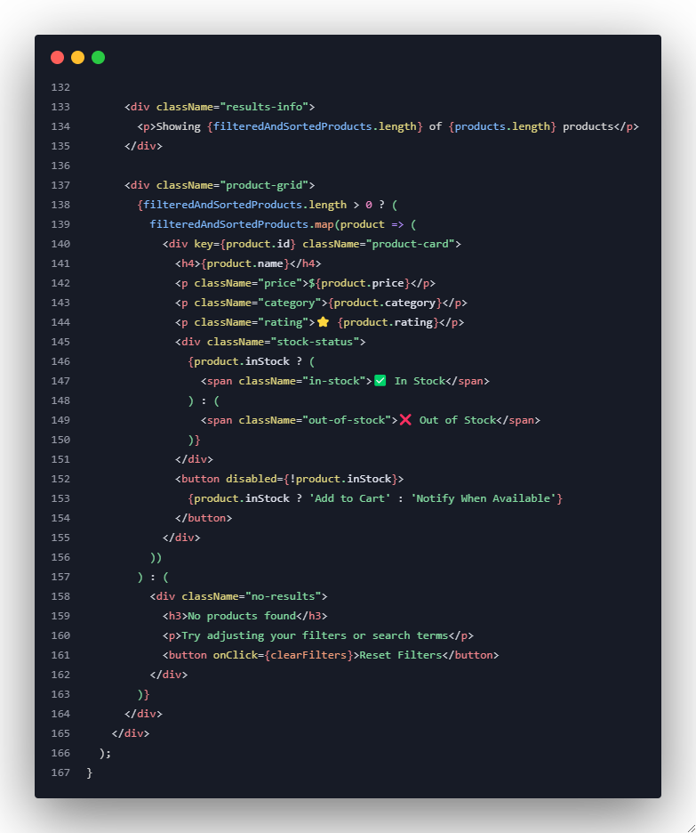
Example 2: Advanced Product Filter and Sort

Slide 16
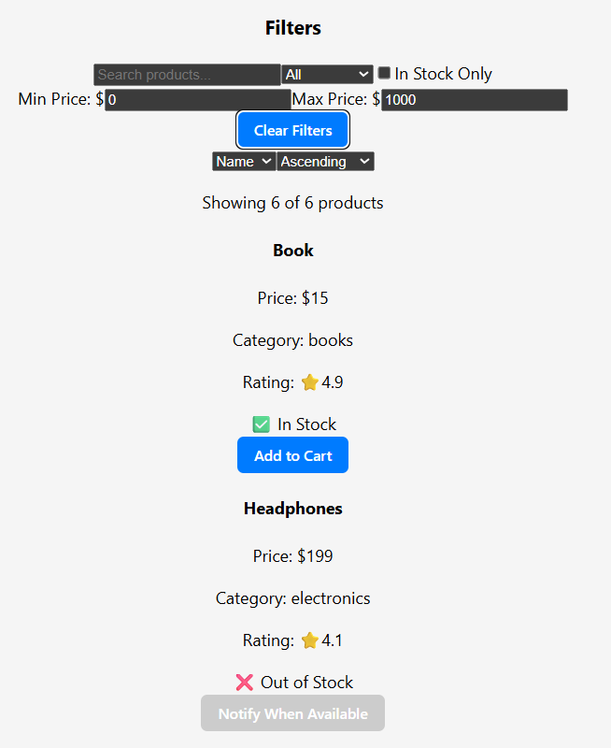
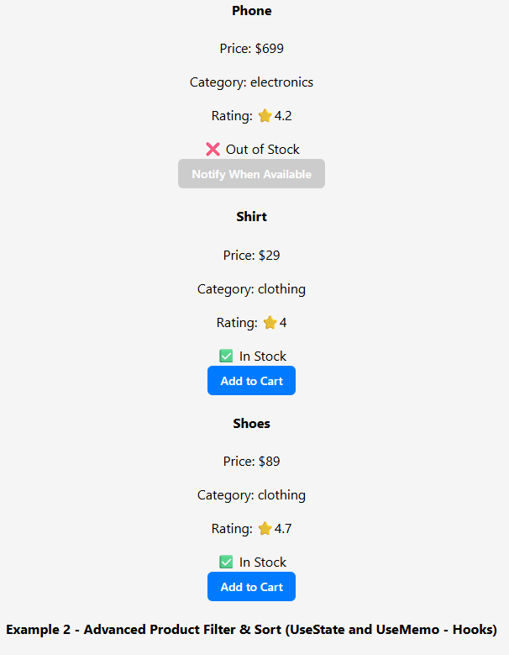
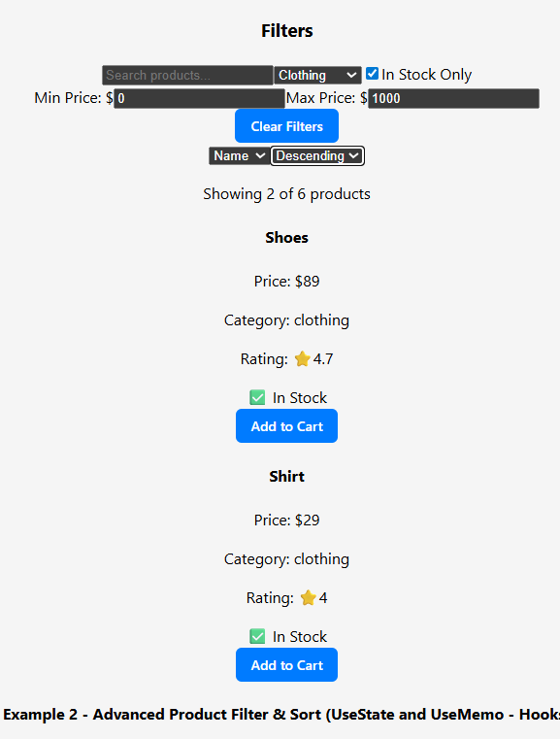
Example 2: Advanced Product Filter and Sort
Default View: On initial load, useMemo runs with the default filters, and the JSX maps over the entire product list, showing all 6 items sorted by name.
User Action & State Change: When a user clicks a filter (e.g., selects "clothing"), an onChange event calls setFilters. This useState function updates the component's state with the new filter information.
Filtered Re-render: The state change forces useMemo to re-run its calculation. It now returns a new, smaller array containing only products that match the "clothing" category. React then re-renders the list, showing only the 2 matching products.
Default View
User Action & State Change
Filtered Re-render (useMemo)

Slide 17
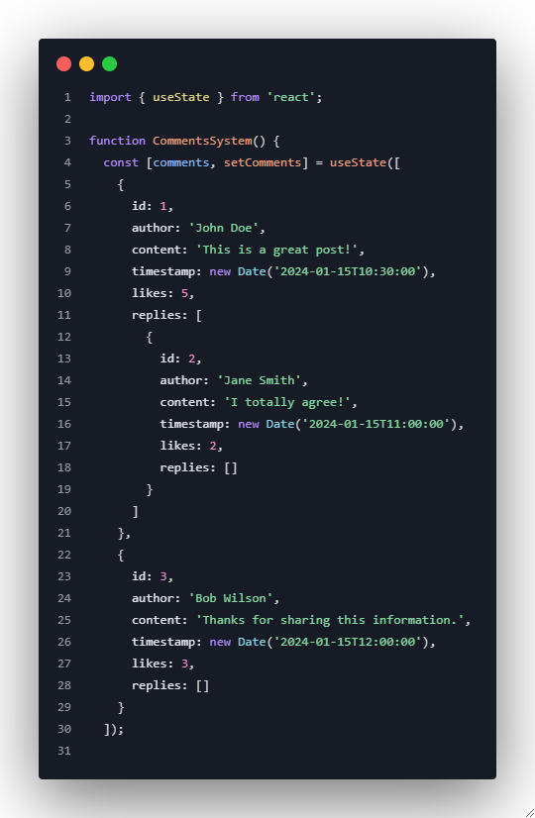
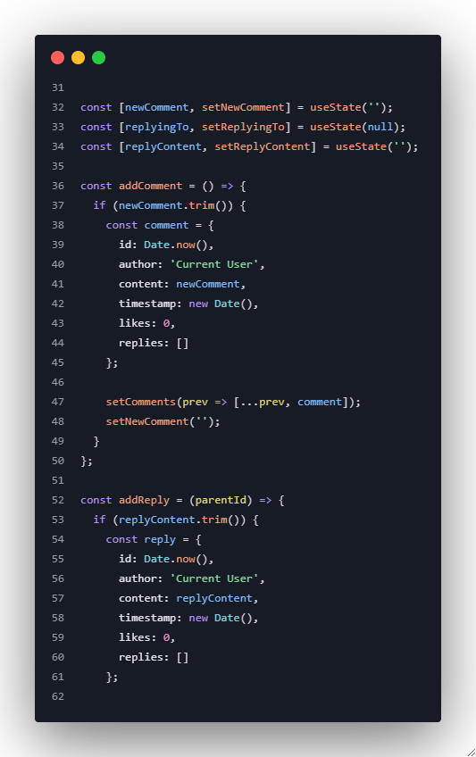
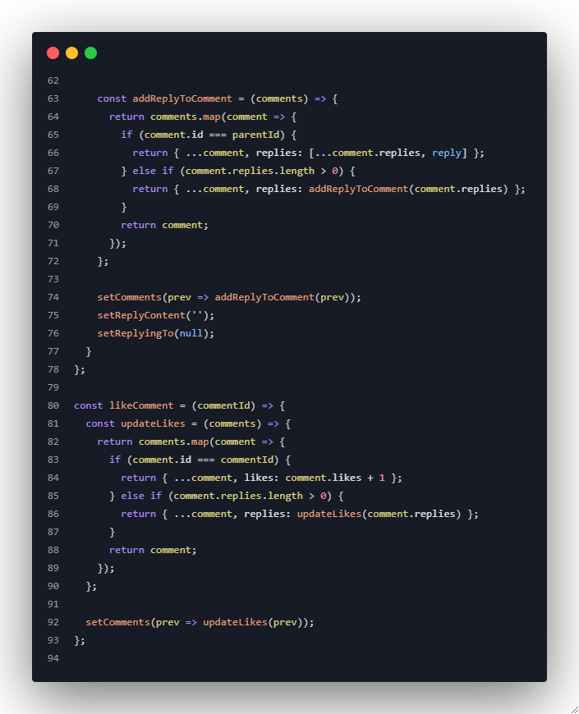
Example 3: Nested Comments System

Slide 18
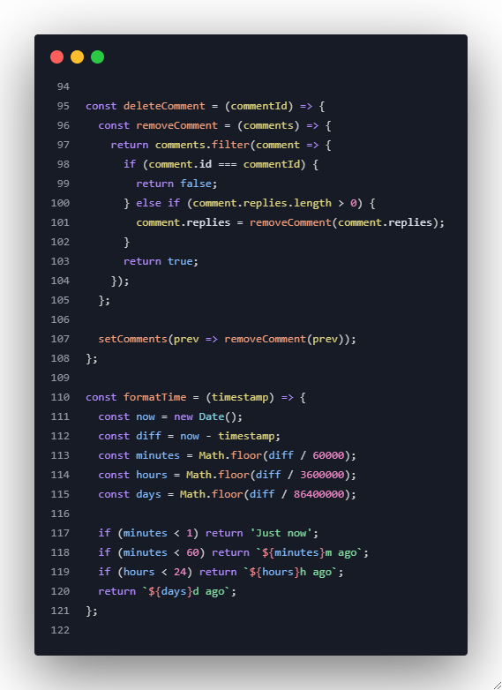
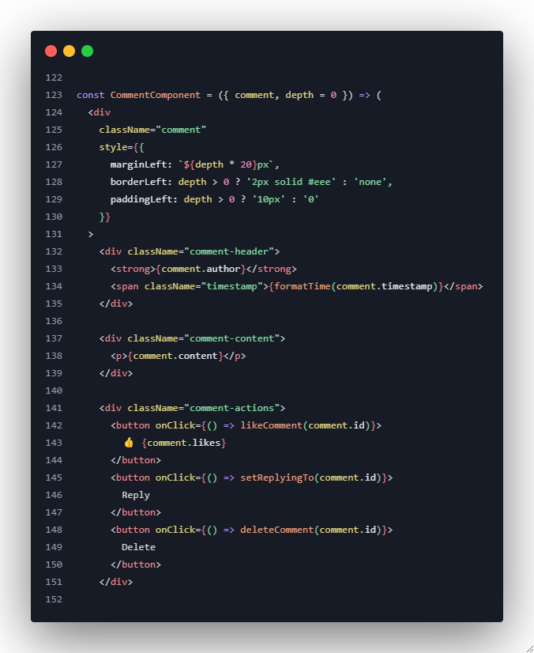
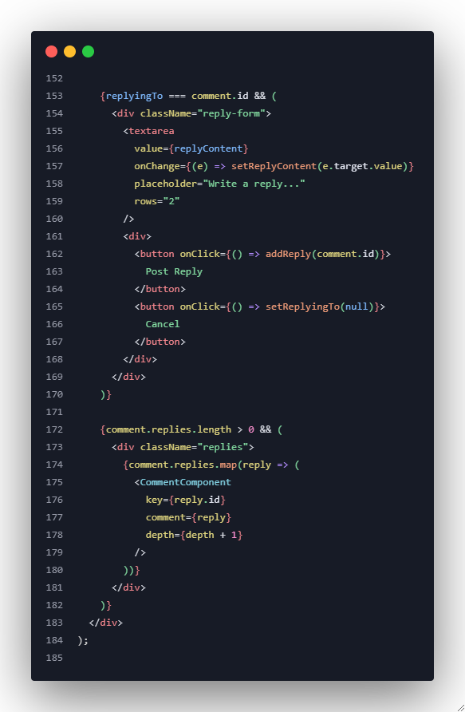
Example 3: Nested Comments System
Notes:
import React, { useState, useCallback, memo } from "react";
/* ---------- Pure helpers (immutable) ---------- */
const addReplyToComments = (comments, parentId, reply) => {
return comments.map(c => {
if (c.id === parentId) {
return { ...c, replies: [...(c.replies || []), reply] };
}
if (c.replies && c.replies.length > 0) {
return { ...c, replies: addReplyToComments(c.replies, parentId, reply) };
}
return c;
});
};
const updateLikesInComments = (comments, targetId) => {
return comments.map(c => {
if (c.id === targetId) {
return { ...c, likes: (c.likes || 0) + 1 };
}
if (c.replies && c.replies.length > 0) {
return { ...c, replies: updateLikesInComments(c.replies, targetId) };
}
return c;
});
};
const removeCommentFromComments = (comments, targetId) => {
// Return a new array without the target comment (search recursively)
return comments
.map(c => {
// If this comment has replies, process them immutably
if (c.replies && c.replies.length > 0) {
return { ...c, replies: removeCommentFromComments(c.replies, targetId) };
}
return c;
})
.filter(c => c.id !== targetId);
};
/* ---------- Small util ---------- */
const formatTime = (timestamp) => {
const now = new Date();
const diff = now - new Date(timestamp);
const minutes = Math.floor(diff / 60000);
const hours = Math.floor(diff / 3600000);
const days = Math.floor(diff / 86400000);
if (minutes < 1) return 'Just now';
if (minutes < 60) return `${minutes}m ago`;
if (hours < 24) return `${hours}h ago`;
return `${days}d ago`;
};
/* ---------- Comment render component (memoized) ---------- */
const Comment = memo(function Comment({
comment,
depth = 0,
onReplyClick,
replyingTo,
replyValue,
onReplyChange,
onPostReply,
onCancelReply,
onLike,
onDelete
}) {
return (
<div
className="comment"
style={{
marginLeft: `${depth * 20}px`,
borderLeft: depth > 0 ? '2px solid #eee' : 'none',
paddingLeft: depth > 0 ? '10px' : '0',
marginBottom: '8px'
}}
>
<div className="comment-header" style={{ display: 'flex', justifyContent: 'space-between' }}>
<div>
<strong>{comment.author}</strong>
<div style={{ fontSize: '12px', color: '#666' }}>{formatTime(comment.timestamp)}</div>
</div>
<div>
<button onClick={() => onLike(comment.id)}>👍 {comment.likes || 0}</button>
<button onClick={() => onReplyClick(comment.id)}>Reply</button>
<button onClick={() => onDelete(comment.id)}>Delete</button>
</div>
</div>
<div className="comment-content">
<p style={{ marginTop: 6 }}>{comment.content}</p>
</div>
{replyingTo === comment.id && (
<div className="reply-form" style={{ marginTop: 6 }}>
<textarea
value={replyValue || ''}
onChange={(e) => onReplyChange(comment.id, e.target.value)}
placeholder="Write a reply..."
rows="2"
style={{ width: '100%' }}
/>
<div style={{ marginTop: 4 }}>
<button onClick={() => onPostReply(comment.id)}>Post Reply</button>
<button onClick={() => onCancelReply()}>Cancel</button>
</div>
</div>
)}
{comment.replies && comment.replies.length > 0 && (
<div className="replies" style={{ marginTop: 8 }}>
{comment.replies.map(r => (
<Comment
key={r.id}
comment={r}
depth={depth + 1}
onReplyClick={onReplyClick}
replyingTo={replyingTo}
replyValue={replyValue}
onReplyChange={onReplyChange}
onPostReply={onPostReply}
onCancelReply={onCancelReply}
onLike={onLike}
onDelete={onDelete}
/>
))}
</div>
)}
</div>
);
});
/* ---------- Main component ---------- */
function CommentsSystem() {
const [comments, setComments] = useState([
{
id: 1,
author: 'John Doe',
content: 'This is a great post!',
timestamp: new Date('2024-01-15T10:30:00').toISOString(),
likes: 5,
replies: [
{
id: 2,
author: 'Jane Smith',
content: 'I totally agree!',
timestamp: new Date('2024-01-15T11:00:00').toISOString(),
likes: 2,
replies: []
}
]
},
{
id: 3,
author: 'Bob Wilson',
content: 'Thanks for sharing this information.',
timestamp: new Date('2024-01-15T12:00:00').toISOString(),
likes: 3,
replies: []
}
]);
const [newComment, setNewComment] = useState('');
const [replyingTo, setReplyingTo] = useState(null);
const [replyContents, setReplyContents] = useState({}); // { [commentId]: 'text' }
const addComment = useCallback(() => {
if (newComment.trim()) {
const comment = {
id: Date.now(),
author: 'Current User',
content: newComment,
timestamp: new Date().toISOString(),
likes: 0,
replies: []
};
setComments(prev => [...prev, comment]);
setNewComment('');
}
}, [newComment]);
const addReply = useCallback((parentId) => {
const content = (replyContents[parentId] || '').trim();
if (!content) return;
const reply = {
id: Date.now(),
author: 'Current User',
content,
timestamp: new Date().toISOString(),
likes: 0,
replies: []
};
setComments(prev => addReplyToComments(prev, parentId, reply));
setReplyContents(prev => {
const copy = { ...prev };
delete copy[parentId];
return copy;
});
setReplyingTo(null);
}, [replyContents]);
const likeComment = useCallback((commentId) => {
setComments(prev => updateLikesInComments(prev, commentId));
}, []);
const deleteComment = useCallback((commentId) => {
setComments(prev => removeCommentFromComments(prev, commentId));
// close reply form if it targeted the deleted comment
setReplyingTo(prev => (prev === commentId ? null : prev));
setReplyContents(prev => {
const copy = { ...prev };
delete copy[commentId];
return copy;
});
}, []);
const handleReplyChange = useCallback((id, text) => {
setReplyContents(prev => ({ ...prev, [id]: text }));
}, []);
const handleReplyClick = useCallback((id) => {
setReplyingTo(id);
// ensure we at least have an entry in replyContents for focus stability
setReplyContents(prev => prev[id] !== undefined ? prev : { ...prev, [id]: '' });
}, []);
const handleCancelReply = useCallback(() => {
setReplyingTo(null);
}, []);
return (
<div className="comments-system" style={{ maxWidth: 700 }}>
<h3>Comments ({comments.length})</h3>
<div className="new-comment" style={{ marginBottom: 12 }}>
<textarea
value={newComment}
onChange={(e) => setNewComment(e.target.value)}
placeholder="Write a comment..."
rows="3"
style={{ width: '100%' }}
/>
<button onClick={addComment} style={{ marginTop: 6 }}>Post Comment</button>
</div>
<div className="comments-list">
{comments.length > 0 ? (
comments.map(comment => (
<Comment
key={comment.id}
comment={comment}
depth={0}
onReplyClick={handleReplyClick}
replyingTo={replyingTo}
replyValue={replyingTo ? replyContents[replyingTo] : ''}
onReplyChange={handleReplyChange}
onPostReply={addReply}
onCancelReply={handleCancelReply}
onLike={likeComment}
onDelete={deleteComment}
/>
))
) : (
<p>No comments yet. Be the first to comment!</p>
)}
</div>
</div>
);
}
export default CommentsSystem;

Slide 19
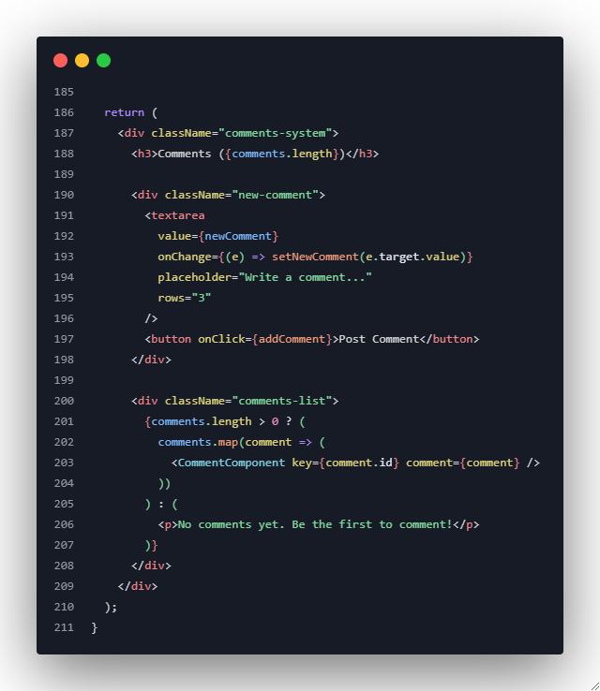
Example 3: Nested Comments System
CommentSystem.css (external styling codes in presenter’s note)
Notes:
CommentComponent.css (External Styles codes)
/* --- General Container Styling --- */
.comments-system {
font-family: -apple-system, BlinkMacSystemFont, "Segoe UI", Roboto,
"Helvetica Neue", Arial, sans-serif;
max-width: 700px;
margin: 40px auto;
padding: 24px;
background-color: #fff;
border: 1px solid #e0e0e0;
border-radius: 8px;
box-shadow: 0 4px 12px rgba(0, 0, 0, 0.08);
}
.comments-system h3 {
margin-top: 0;
color: #333;
}
/* --- New Comment / Reply Form Styling --- */
.new-comment,
.reply-form {
margin-bottom: 20px;
display: flex;
flex-direction: column;
gap: 10px;
}
.new-comment textarea,
.reply-form textarea {
width: 100%;
padding: 12px;
border: 1px solid #ccc;
border-radius: 6px;
font-size: 14px;
font-family: inherit;
resize: vertical;
box-sizing: border-box;
transition: border-color 0.2s;
}
.new-comment textarea:focus,
.reply-form textarea:focus {
outline: none;
border-color: #007bff;
}
.new-comment button,
.reply-form button {
align-self: flex-end; /* Aligns button to the right */
}
/* --- Individual Comment Styling --- */
.comment {
padding: 16px;
border-radius: 6px;
background-color: #f9f9f9;
margin-top: 15px;
position: relative; /* Needed for the vertical connector line */
}
/* This creates the visual line connecting replies to their parent */
.comment .comment {
background-color: #fff;
border: 1px solid #eee;
}
.comment-header {
display: flex;
align-items: center;
gap: 10px;
margin-bottom: 8px;
}
.comment-header strong {
font-size: 15px;
color: #111;
}
.comment-header .timestamp {
font-size: 12px;
color: #888;
}
.comment-content p {
margin: 0 0 12px 0;
color: #444;
line-height: 1.6;
}
/* --- Action Buttons (Like, Reply, Delete) --- */
.comment-actions {
display: flex;
gap: 8px;
margin-bottom: 10px;
}
.comment-actions button {
background: none;
border: none;
padding: 4px 8px;
font-size: 13px;
font-weight: 600;
color: #555;
cursor: pointer;
border-radius: 4px;
transition: background-color 0.2s, color 0.2s;
}
.comment-actions button:hover {
background-color: #e9e9e9;
color: #000;
}
/* --- Reply Form Specifics --- */
.reply-form {
border: 1px solid #e0e0e0;
padding: 15px;
margin-top: 15px;
border-radius: 6px;
background-color: #fff;
}
.reply-form div {
display: flex;
justify-content: flex-end;
gap: 10px;
}
/* --- General Button Styling --- */
button {
padding: 8px 16px;
font-size: 14px;
font-weight: 600;
border: none;
border-radius: 6px;
cursor: pointer;
background-color: #007bff;
color: white;
transition: background-color 0.2s;
}
button:hover {
background-color: #0056b3;
}
/* Secondary button style for 'Cancel' */
.reply-form button:last-of-type {
background-color: #6c757d;
}
.reply-form button:last-of-type:hover {
background-color: #5a6268;
}
/* --- Empty State --- */
.comments-list > p {
text-align: center;
color: #888;
padding: 40px;
background-color: #fafafa;
border-radius: 6px;
}

Slide 20
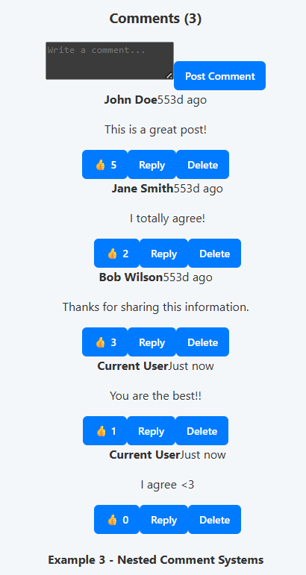
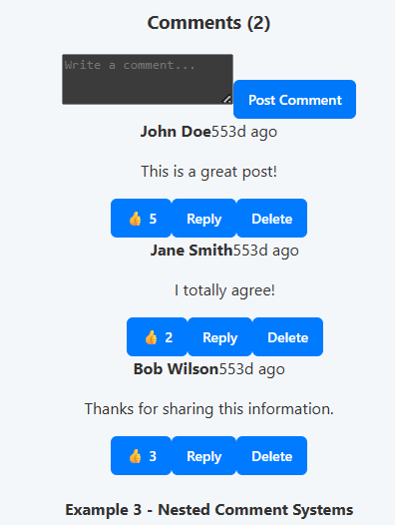
Example 3: Nested Comments System
State Update on Action: When a user adds a comment or a reply, a function like addComment or addReply is triggered. These functions create a new comment object and use setComments to update the main state array with the new data, either at the top level or nested inside the correct parent.
Automatic Re-render: The setComments call triggers a full re-render of the component. React then maps over the newly updated comments array, and the recursive logic automatically draws the new comments and replies in their correct nested positions, as seen in the "after" image.
Recursive Component: The core of this example is a CommentComponent that renders itself. It maps over its own replies array and creates a new <CommentComponent /> for each reply, passing an increased depth prop to create the visual indentation.
Default View
State Update and Re-render

Slide 21
Exercise 1: Weather Dashboard
Task: Build a weather dashboard with conditional rendering
Requirements:
Display different weather icons based on conditions
Show/hide detailed forecast based on user preference
Conditional styling for temperature ranges
Loading states and error handling
Empty state when no location is selected
Notes:
import { useState } from "react";
function WeatherDashboard() {
const [weather, setWeather] = useState('');
const [showDetails, setShowDetails] = useState(false);
const [isLoading, setIsLoading] = useState(false);
const [error, setError] = useState('');
const [temperature, setTemperature] = useState(null);
const handleSelect = (condition) => {
setIsLoading(true);
setError('');
setTimeout(() => {
if (condition === '') {
setError('Please select a location.');
setIsLoading(false);
return;
}
setWeather(condition);
setTemperature(Math.floor(Math.random() * 35));
setIsLoading(false);
}, 1000);
};
return (
<div>
<h2>Weather Dashboard</h2>
<select onChange={(e) => handleSelect(e.target.value)}>
<option value="">-- Select Location --</option>
<option value="sunny">Melaka</option>
<option value="rainy">Sabah</option>
<option value="cloudy">Sarawak</option>
</select>
{isLoading && <p>Loading weather...</p>}
{error && <p style={{ color: 'red' }}>{error}</p>}
{!isLoading && weather && (
<div>
<p>Weather: {weather}</p>
<p style={{ color: temperature > 30 ? 'red' : 'blue' }}>
Temperature: {temperature}°C
</p>
<button onClick={() => setShowDetails(!showDetails)}>
{showDetails ? 'Hide Forecast' : 'Show Forecast'}
</button>
{showDetails && <p>Detailed Forecast: It might change later.</p>}
</div>
)}
</div>
);
}
export default WeatherDashboard;

Slide 22
Exercise 2: Task Management with Categories
Task: Create a task manager with dynamic filtering
Requirements:
Add tasks with different priorities and categories
Filter by completion status, priority, and category
Conditional rendering for overdue tasks
Bulk actions (select all, delete selected)
Empty states for different filter combinations
Notes:
import { useState } from "react";
function TaskManager() {
const [tasks, setTasks] = useState([]);
const [input, setInput] = useState("");
const [priority, setPriority] = useState("normal");
const [category, setCategory] = useState("general");
const [filterStatus, setFilterStatus] = useState("all");
const [filterPriority, setFilterPriority] = useState("all");
const [filterCategory, setFilterCategory] = useState("all");
const addTask = () => {
if (input.trim() === "") return;
const newTask = {
id: Date.now(),
text: input,
completed: false,
priority: priority,
category: category,
dueDate: new Date(Date.now() - 86400000), // set yesterday for overdue demo
};
setTasks([...tasks, newTask]);
setInput("");
setPriority("normal");
setCategory("general");
};
const toggleComplete = (id) => {
setTasks(
tasks.map((task) =>
task.id === id
? {
...task,
completed: !task.completed,
}
: task
)
);
};
const deleteSelected = () => {
setTasks(tasks.filter((task) => !task.completed));
};
const selectAll = () => {
setTasks(tasks.map((task) => ({ ...task, completed: true })));
};
const filteredTasks = tasks.filter((task) => {
const matchStatus =
filterStatus === "all"
? true
: filterStatus === "completed"
? task.completed
: !task.completed;
const matchPriority =
filterPriority === "all" ? true : task.priority === filterPriority;
const matchCategory =
filterCategory === "all" ? true : task.category === filterCategory;
return matchStatus && matchPriority && matchCategory;
});
return (
<div>
<h2>Task Manager</h2>
<input
type="text"
value={input}
onChange={(e) => setInput(e.target.value)}
placeholder="Enter task..."
/>
<select value={priority} onChange={(e) => setPriority(e.target.value)}>
<option value="low">Low</option>
<option value="normal">Normal</option>
<option value="high">High</option>
</select>
<select value={category} onChange={(e) => setCategory(e.target.value)}>
<option value="general">General</option>
<option value="work">Work</option>
<option value="home">Home</option>
</select>
<button onClick={addTask}>Add Task</button>
<div style={{ marginTop: "1em" }}>
<strong>Filter:</strong>
<select
value={filterStatus}
onChange={(e) => setFilterStatus(e.target.value)}
>
<option value="all">All</option>
<option value="completed">Completed</option>
<option value="active">Active</option>
</select>
<select
value={filterPriority}
onChange={(e) => setFilterPriority(e.target.value)}
>
<option value="all">All Priorities</option>
<option value="low">Low</option>
<option value="normal">Normal</option>
<option value="high">High</option>
</select>
<select
value={filterCategory}
onChange={(e) => setFilterCategory(e.target.value)}
>
<option value="all">All Categories</option>
<option value="general">General</option>
<option value="work">Work</option>
<option value="home">Home</option>
</select>
</div>
<div style={{ marginTop: "1em" }}>
<button onClick={selectAll}>Select All</button>
<button onClick={deleteSelected}>Delete Selected</button>
</div>
{filteredTasks.length === 0 ? (
<p>No tasks found based on current filters.</p>
) : (
<ul>
{filteredTasks.map((task) => {
const isOverdue = !task.completed && task.dueDate < new Date();
return (
<li key={task.id} style={{ color: isOverdue ? "red" : "black" }}>
<input
type="checkbox"
checked={task.completed}
onChange={() => toggleComplete(task.id)}
/>
<strong>{task.text}</strong> |{" "}
<em>{task.priority.toUpperCase()}</em> |{" "}
<span>{task.category}</span>
{isOverdue && " (Overdue!)"}
</li>
);
})}
</ul>
)}
</div>
);
}
export default TaskManager;

Slide 23
Key Learning Outcomes
By the end of this session, you will be able to:
✅ Master all conditional rendering techniques in React
✅ Render dynamic lists efficiently with proper key usage
✅ Handle complex filtering and sorting scenarios
✅ Implement proper loading and error states
✅ Create responsive UIs that adapt to different

